Slide 1
Big Sisters Match Guidelines During COVID-19 Guidelines for staying safe while participating in our mentoring programs (Updated September 2020)
Notes:
In this training we refer to health and safety guidelines issued by the BC Ministry of Health. We ask every family stay updated on all BC health guidelines for the prevention of COVID-19.
We want our mentors and mentees to be able to practice safe physical distancing and hygiene practices before, during, and after every mentoring opportunity, now and in the future.

Slide 2
About this Training Guide
This guide is intended to help mentors, mentees and staff with Big Sisters of BC Lower Mainland navigate the world of mentoring during a public health crisis such as the COVID-19 pandemic.
Mentoring at this point in time, and for the foreseeable future, means doing things differently. While our mentors and mentees will continue to build developmental relationships together, some match activities that mentors and mentees would typically select, or activities that mentors and mentees would do together to help the community, might have to adapt to meet current public health safety standards.
All recommendations made in this training guide are based upon current protocols provided by the Provincial Health Office, Government of Canada, and World Health Organization, as well as best-practices in volunteering from Volunteer Canada and Volunteer Victoria.
These recommendations are subject to change as new information emerges. Directives announced by the Provincial Health Officer and Government of Canada officials should always take precedence over this guide:
Provincial Health Office: https://www2.gov.bc.ca/gov/content/health/about-bc-s-health-care-system/office-of-the-provincial-health-officer/current-health-topics/covid-19-novel-coronavirus
Government of Canada: https://www.canada.ca/en/public-health/services/diseases/coronavirus-disease-covid-19.html
World Health Organization: https://www.who.int/emergencies/diseases/novel-coronavirus-2019

Slide 3
Update to Guidelines
What to consider prior to resuming hang outs at each others’ homes:
If both parties are comfortable expanding their bubbles to include hang outs at each others’ homes please keep in mind:
That your bubble will now include others that are in contact with your Big/Little
That being indoors increases your risk of contracting and spreading COVID-19
That you should still keep your distance and wear a mask when appropriate
That you should still refrain from sharing food/drinks and bring snacks
Taking a self assessment questionnaire immediately before your hang out and encourage your Big/Little to do the same https://bc.thrive.health/covid19/en
Notes:
What feels right for you today, might not feel appropriate or safe next week, next month or in the fall. This chart is designed to help you think about what’s appropriate for you when it comes to face-to-face contact with your child’s mentor.
If you or anyone in your family has underlying health concerns, we recommend that you only select no-contact match activities during a COVID-19 outbreak. If you are not vulnerable in any way and you are risk tolerant, you may have no concerns about meeting face-to-face under any circumstances. However, we ask you to consider how you will mitigate risks to your health and those of you/ your mentor and/or other family members. You may want to match visits to occur less frequently in a face-to-face manner and move to a mix of online/virtual communication channels.

Slide 4
What Type of Match Activities are Safe?
HIGH CONTACT ACTIVITIES (extreme/considerable risk level) | LOW CONTACT ACTIVITIES (limited/slight risk level) | NO CONTACT ACTIVITIES (zero risk level)
Not Currently Allowed | May be allowed *Follow Public Health office rules *Check with caseworker and mentee’s parent/guardian before doing this type of activity | Activity Allowed
Face-to-face contact between mentors and mentees where time together occurs inside public places or around larger groups. | Face-to-face contact between mentors and mentees occurs outdoors using safe physical-distancing or at each others’ homes wearing masks when needed | -No face-to-face contact between mentors and mentees (or mentees and mentors volunteering together to help other people) - activities take place alone or virtually
Sharing food Overnights Public events/indoor places | Bike rides/Walks/hikes Hanging out at each others’ homes Picnics | Phone calls Texts Virtual meetings
Notes:
High contact activities, where the Mentee and their Mentor are face-to-face, spending time in each other’s homes, playing sports, or sharing food are not allowed right now, or during any other COVID-19 outbreak in the future.
Low-contact activities – such as bike rides, kicking the soccer ball, walks/hikes may be allowed if everyone follows safe-distancing practices and everyone has agreed to it.
No contact activities – activities and projects that matches can complete in collaboration together, but work on separately, are ideal during an outbreak. This includes activities such as calling or texting each other, online video games, setting up virtual meetings to bake, play games, do crafts – anything that encourages both to stay positive but keeps you away from others.

Slide 5
What might have changed while mentoring during COVID-19?
ACCESS
How Bigs and Littles visit will need to adapt during any COVID-19 outbreaks. They may be switching between face-to-face and virtual meetings to keep consistently connecting each week, depending on their program and the permission granted by all match participants.
Everyone has different levels of access to technology, so use the method of communication that works best for your match – Zoom, Face-time, Google hang-outs, email, text, telephone or old-fashioned paper and pen. Just remember to talk to each other about the virtual platforms or online tools that you feel comfortable using and update your caseworker during your next match monitoring check-in.
Privacy
You may now have video access into each other’s homes or private spaces. It is important to respect each other’s privacy.
Also, let each other know if there are other people in the room during your match meetings and agree that this is ok with both of you before you continue. You may decide it is better to find another space and/or time to connect.

Slide 6
Determining Your Risk Tolerance
What to consider prior to resuming in person meetings:
There are important factors to consider when making the decision to resume in person meetings between your child and their mentor, including the Mentor and Mentee’s level of risk and the level of risk of other members of your family.
There are certain individuals who are at risk of a more severe illness as a result of COVID-19, including:
Individuals over 60 years of age
Individuals with a compromised immune system or underlying chronic medical conditions
It is important to properly inform yourself and others of these risks, assess your own risk-tolerance, and think through extra precautions you may wish to take over the coming months.
It is okay if you are not comfortable to resume in person meetings at this time. Please let your caseworker know how you feel.
Notes:
What feels right for you today, might not feel appropriate or safe next week, next month or in the fall. This chart is designed to help you think about what’s appropriate for you when it comes to face-to-face contact with your child’s mentor.
If you or anyone in your family has underlying health concerns, we recommend that you only select no-contact match activities during a COVID-19 outbreak. If you are not vulnerable in any way and you are risk tolerant, you may have no concerns about meeting face-to-face under any circumstances. However, we ask you to consider how you will mitigate risks to your health and those of you/ your mentor and/or other family members. You may want to match visits to occur less frequently in a face-to-face manner and move to a mix of online/virtual communication channels.

Slide 7
Prepare
Be prepared for more changes in the months ahead.
Minimize
Do not call at each other's homes unannounced. Let people know to expect you.
Only you and your mentee ride in your vehicle together. Wear your mask on public transit
Bring your own food/water. Do not share food/plates/cutlery.
Maintain
Wash your hands before and after EVERY match activity. When you get home, wash your hands, wash your clothes, and wash your hands again.
Sanitize everything you bring to/take from your match activities.
Mentors must clean their vehicle before and after each match meeting.
Resume
Keep doing activities and stay connected.
Have hand sanitizer, tissues, masks and gloves ready.
Avoid physical contact - stay 6 ft apart. No high fives or hugs.
Hang out at each others’ homes while following safety guidelines
BE PREPARED: RESUMING IN PERSON MATCH ACTIVITIES
Adapted from contributions made by Volunteer Canada, Volunteer Ireland,
Volunteer Israel,
BC Health)

Slide 8
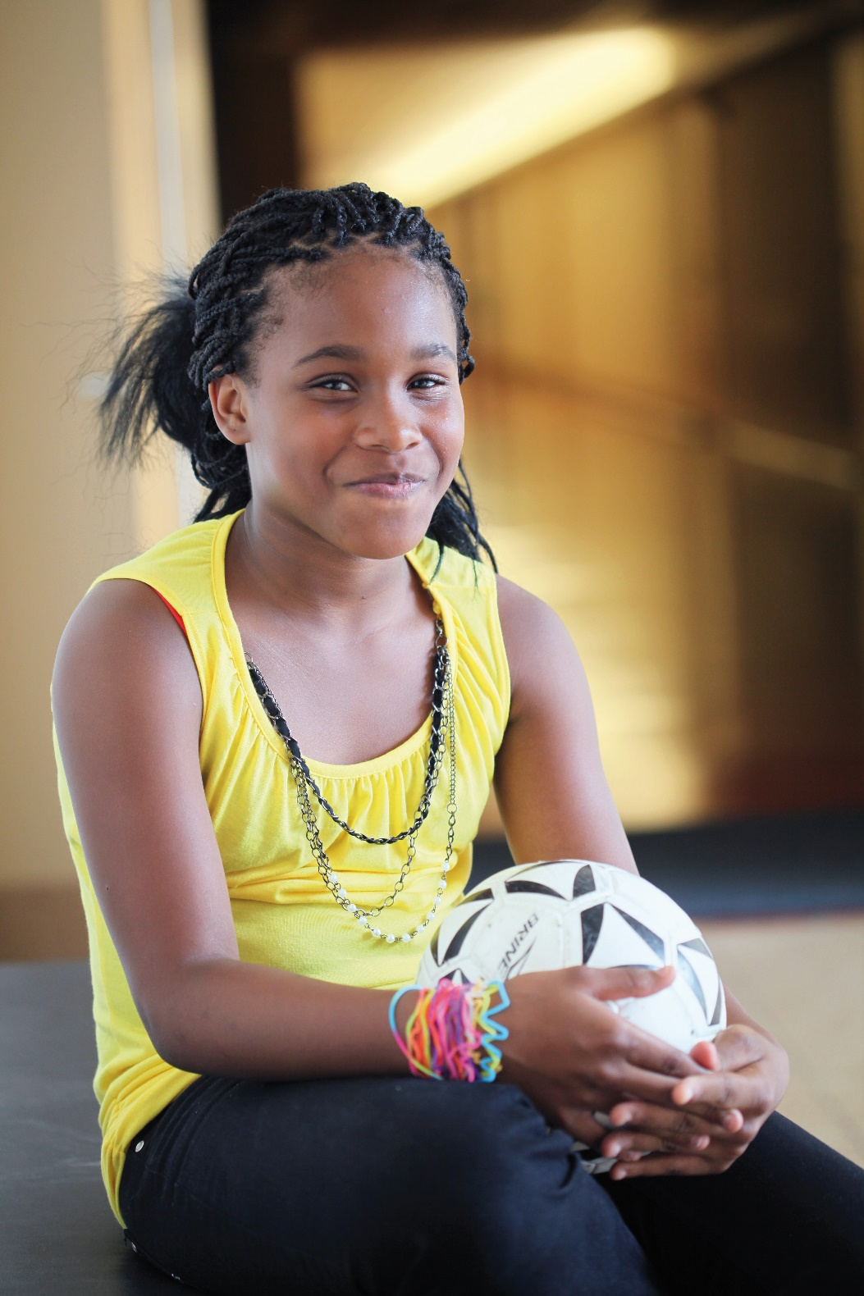
Virtual Meetings - The Good Stuff
You might choose to continue “no contact” or virtual meetings at this time.
Talk about future plans.
Help think of fun ways to connect in the virtual world:
Take virtual tours through galleries, museums, or parks
Wear costumes
Create your own cheer or chant
Host a virtual home-based scavenger hunt – give yourself a time-limit
Sing together
Teach each other dance moves
Draw together using an online white-board
Practice your paired reading or writing activities
Pick a great movie/ book to watch/read and set a time to compare notes
Use software to share your screen – let them see what you're doing online
Agree to a schedule for calls/connections. When people feel a loss of control in times such as these, a sense of routine offers consistency and may reduce anxiety. Mentors should always end the call by scheduling the next one.
Remember: it’s ok to be worried but there are lots of positive things we can all do to keep everyone safe

Slide 9
BC’S RESTART PLAN (www.gov.bc.ca) last updated May 29/20
WHAT THE “NEW NORMAL” MEANS FOR YOU?
BC’s progress in the fight against COVID-10 is a direct result of the sacrifices and decisions that we have all made. To continue to protect seniors and at risk people and ensure that our health care system can respond to this dangerous virus, means that we all have to keep doing our part – at home, in the community and at work.
Stay at home and keep a safe distance from family when you have cold or flu symptoms (coughing, sneezing, runny nose, sore throat, fatigue)
No handshaking or hugs outside of your family
Practice good hygiene
Regular hand washing
Avoid touching your face
Covering coughs and sneezes
Disinfect frequently touched surfaces
Keep physical distancing, as much as possible when in the community and where not possible, considering using a non-medical mask or face covering.
Notes:
It is essential to keep informed and aware of the advice provided by BC Health Authorities. These guidelines are created to keep transmission low. The above information is taken directly from BC’s restart plan – more information can be found on www.gov.bc.ca

Slide 10
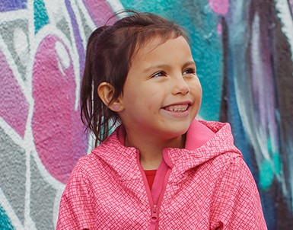
Importance of Self-Monitoring:
Even if gatherings are allowed and social distancing rules are maintained, it might not be safe for match particpants to see each other face-to-face.
You need to ask yourself every time there is a match activity:
Is anyone feeling ill? If the answer is YES for either of you DO NOT MEET IN PERSON
Has anyone had COVID-19 symptoms in the last 14 days? If the answer is YES for either or you DO NOT MEET IN PERSON
Did anyone have direct contact with someone in their households who has been unwell in the last 14 days? If the answer is YES for either of you DO NOT MEET IN PERSON
Community safety guidelines are constantly changing as more information becomes available. As a mentor, it is your responsibility to check and understand those guidelines as well as those established by Big Sisters.

Slide 11
Frequently Asked Questions
Can we share items? It is best that if they are doing an activity that requires an item to be touched with their hands (ie. basketball) that each of them have their own item
Can we include others during our match activities? Keep match activities to just match participants, even if they are meeting online or through a virtual platform.
Should we wear masks? A non-medical cloth mask collects droplets caused by sneezing, coughing, laughing, etc. Wearing a mask should be combined with other important preventative measures such as frequent hand washing and physical distancing. Using only a mask is not enough to prevent the spread of COVID-19.
Should my mentor and I be going to public events? Always follow the instructions set out by BC’s Provincial Health Officer and/or Government of Canada officials. If they say it’s ok to be outside, to meet with others who are not household members, and to attend public events, then go ahead. As long as you feel comfortable and it's an agency approved activity, then it's ok to it.

Slide 12
Self-Monitoring
Self-Isolation
SELF-MONITOR means to: monitor yourself for 14 days for one or more symptoms of COVID-19. Go about your day but avoid crowded places and increase your personal space from others, whenever possible
SELF-ISOLATE means to: stay at home and monitor yourself for symptoms, even if mild, for 14 days; avoid contact with other people to help prevent the spread of disease in your home and in your community in the event you become symptomatic.
Isolation
To be ISOLATED means to: stay at home until your Public Health Authority advises you that you are no longer at risk of spreading the virus to others; and avoid contact with other people to help prevent the spread of disease in your home and in your community, particularly people at high risk of severe illness outcomes such as older adults or medically vulnerable people
You have: no symptoms AND a history of possible exposure to the novel coronavirus due to travel outside of Canada or close contact with a person diagnosed with COVID-19
You have: no symptoms AND a history of possible exposure to the novel coronavirus that causes COVID-19, in the last 14 days
You have: symptoms, even if mild AND you have been diagnosed with COVID-19 or are waiting for the results of a lab test for COVID-19
You need to self-monitor if: you have reason to believe you have been exposed to a person with COVID-19 OR you are in close contact with older adults or medically vulnerable people OR you have been advised to self-monitor for any other reason by your Public Health Authority
You need to self-isolate if: you have travelled outside of Canada within the last 14 days OR your Public Health Authority has identified you as a close contact of someone diagnosed with COVID-19
You need to isolate if: you have been diagnosed with COVID-19 OR you are waiting to hear the results of a laboratory test for COVID-19 OR you have been advised to isolate at home for any other reason by your Public Health Authority
KNOW THE DIFFERENCE:
For more information about COVID-19 definitions, contact the Public Health Agency of Canada at
1-833-784-4397 or visit canada.ca/coronavirus

Slide 13
Acknowledgement and Gratitude
We gratefully acknowledge that our mentors, mentees and staff live, learn and work on the unceded territories of the Tsleil-Watuth, Squamish, Kwantlen, Matsqui, Tsawwassen, Katzie, and Musqueam First Nations.
Thanks to all the Big Sisters of BC Lower Mainland volunteers, families and supporters who make it possible to keep supporting children and youth during this difficult time.
Thanks to Volunteer Victoria for allowing us to adapt their COVID-19 Volunteer Training. Volunteer Victoria’s mission is to inspire everyone to volunteer. They raise new generations of volunteers; provide training and expertise to volunteer-led groups and organizations; and create opportunities to make a difference.
T: 250-386-2269 | E: volvic@volunteervictoria.bc.ca | W: volunteervictoria.bc.ca
Notes:
This training has been adapted from a training program developed by Volunteer Victoria, a volunteer centre serving people of all ages and organizations of all kinds, across all of Greater Victoria. Their mission is to inspire everyone to volunteer. We also refer to materials shared with them by Volunteer Management Specialists from Canada, Ireland, and Israel. We are grateful to all who contributed to the guide.

Slide 14
We’re here for you!
Talk to your caseworker if you have any questions or concerns
We are all learning in this “next” normal
If you or your family needs any extra support during this time please let us know
Notes:
It is essential to keep informed and aware of the advice provided by BC Health Authorities. These guidelines are created to keep transmission low. The above information is taken directly from BC’s restart plan – more information can be found on www.gov.bc.ca

